Slide 1
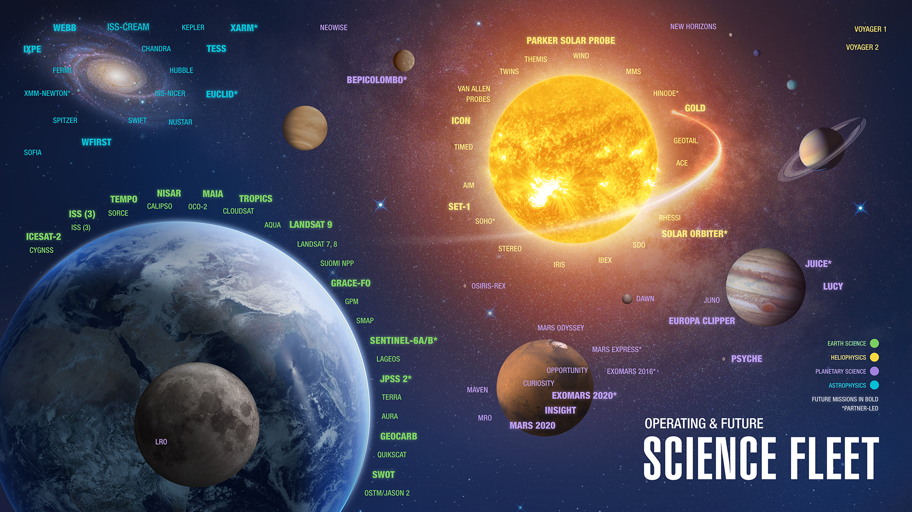
The View from NASA Headquarters
As of November 21, 2017
Hank Margolis, Program Manager, NASA Terrestrial Ecology Program

Slide 2

NASA Science Mission Directorate (SMD) Top-Level Goals
Astrophysics: Discovering the Secrets of the Universe
Planetary Sciences: Searching for Life in the Solar System and Beyond & Understanding Our Solar System and It’s Components
Earth Science and Heliophysics: Safeguarding and Improving Life on Earth

Slide 3













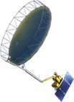



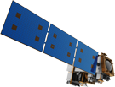

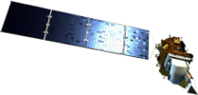

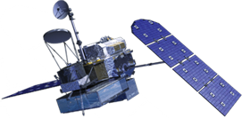

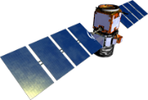

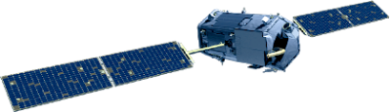
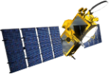
NASA Earth Science
Missions: Present through 2023
PREFIRE (2) (TBD)
(Pre)Formulation
PACE (2022)
Implementation
TSIS-2 (2020)
GeoCARB (~2021)
Primary Ops
TROPICS (12) (~2021)
Extended Ops
MAIA (~2021)
Landsat 9 (2020)
NI-SAR
(2021)
Sentinel-6A/B (2020, 2025)
ISS Instruments
LIS (2020), SAGE III (2020)
TSIS-1 (2018), ECOSTRESS (2019), GEDI OCO-3 (2021), (2020)
CLARREO-PF (2020), EMIT (TBD)
SWOT (2021)
TEMPO (2018)
InVEST/CubeSats
RAVAN (2016)
RainCube (2018)
TEMPEST-D (2018)
CubeRRT (2018)
CSIM (2018)
CIRiS (2019)
HARP (2019)
SNoOPI*
HyTI*
CTIM*
TACOS*
* Launch date TBD
ICESat-2 (2021)
GRACE-FO (2) (2023)
CYGNSS (8) (2019)
JPSS-2 Instruments
OMPS-Limb (2019)
SMAP
(>2022)
Landsat 7
(USGS) (~2022)
NISTAR, EPIC
(DSCOVR /
NOAA) (2019)
SORCE,
TCTE (NOAA) (2017)
Suomi NPP (NOAA) (>2022)
Terra (>2021)
Landsat 8
(USGS) (>2022)
Aqua (>2022)
CloudSat (~2018)
GPM (>2022)
CALIPSO (>2022)
Aura (>2022)
OSTM/Jason-2 (NOAA) (>2022)
OCO-2 (>2022)
03.06.19
Notes:
Fleet - Earth Science Division - Missions (with color key; editable)
Aug. 18, 2018: GRACE-FO and ECOSTRESS moved to prime ops; QuickSCAT removed due to pending decommission; MAIA moved to implementation
Jan. 16, 2018: Reformatted, includes all missions, dates and cube sats
Dec. 15, 2015
Credit: NASA/J. Mottar
------------------------------
SLIDE INFO
CORRECTION DENNING PER RIVERA Feb 18, 2016
Changed misspelling of “Sentinal” to “Sentinel”
UPDATE DENNING PER FREILICH DECISIONS FEB 12, 2016
Changed OCO-3 to Formulation color and moved lower in list
Changed RBI to Formulation color
Changed GEDI to Implementation color and moved to line above it
Added TSIS-2 in Formulation color
UPDATE DENNING PER FREILICH DECISIONS FEB 4, 2016
Changed “Altimetry FO (Formulation in FY16) to “Sentinal-6A/B”
On Landsat 9, removed comma and TIRFF
Change I was going to make – “NISTAR, EPIC (NOAA’s DSCOVR) to green primary ops was already corrected
Dec. 15, 2015 – Updated: TEMPO changed to Implementation phase; NISTAR, EPIC changed to Primary Ops phase; ; OCO-3 and ECOSTRESS changed to Implementation phase; Aquarius removed; slide now fully editable. JMottar
May 18, 2015 – Added to SMD Multimedia Library.
May 18, 2015 – Updated the outdated 2014 version: TRMM was removed; NISTAR, EPIC (NOAA's DSCOVR) were added; SMAP icon was updated; moon at top left was removed; color key moved to top left.-JMottar
ID: I-EA-15-0040 (image)
ID: SL-EA-15-0068 (slide)

Slide 4



Carbon Cycle & Ecosystems Focus Area
How are ecosystems changing in response to environmental change and human actions?
How will they change in the future?
How do changes to ecosystems impact the other components of the Earth system?
How can carbon cycle and ecosystem science improve our capacity for mitigation and adaption to environmental change?
Terrestrial Ecology is the largest program in the Research & Analysis section of
NASA’s Earth Science Division

Slide 5
The View From HQ
2018/2019 were (and continue to be) busy for the NASA Terrestrial Ecology Program
Some TE Highlights since we last met in January 2018
ABoVE Airborne Campaigns – 2018 & 2019
Funded 15 new Carbon Monitoring System (CMS) projects in 2018
CMS 2018 solicitation is on the streets
Funded ~10 new Terra-Aqua-SNPP (Land) awards
New Investigator Program – funded 10 new TE awards
FINESST Graduate Fellowships 2019
Earth Venture Instrument 5 (EVI-5) solicitation
Earth Venture Suborbital-3 solicitation --- Delta-X selected
OCO-2 Science Team

Slide 6
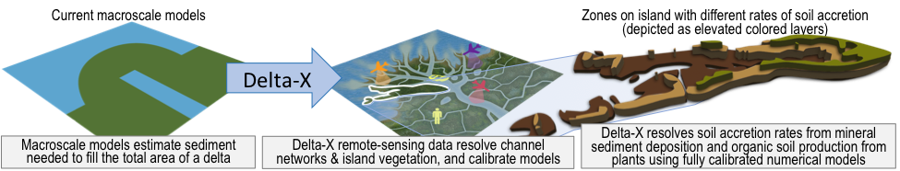
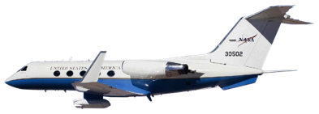
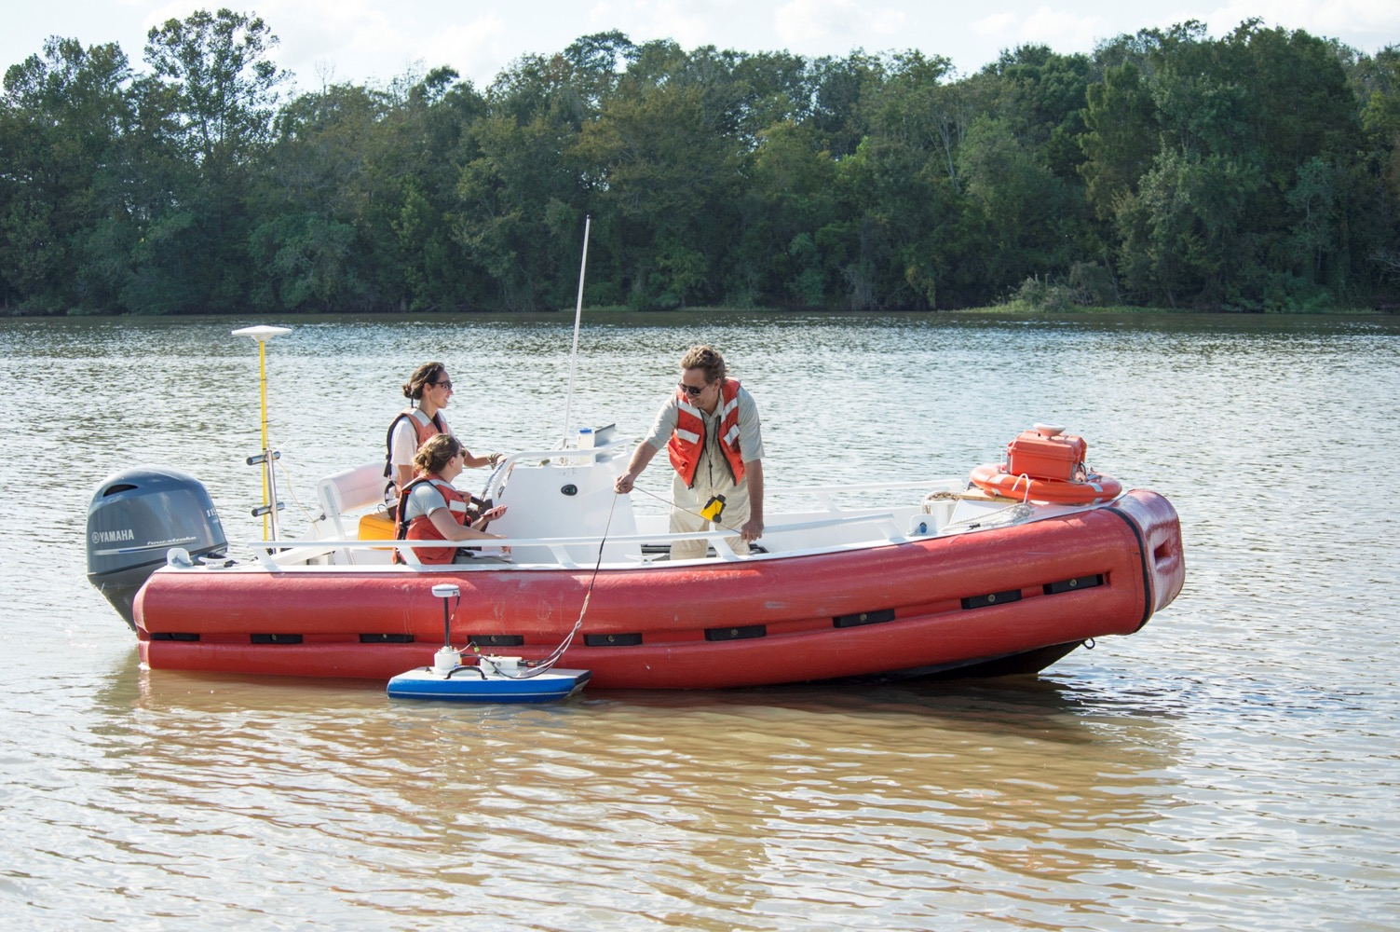
Earth Venture Suborbital 3 Delta-X
Mississippi River Delta

Slide 7
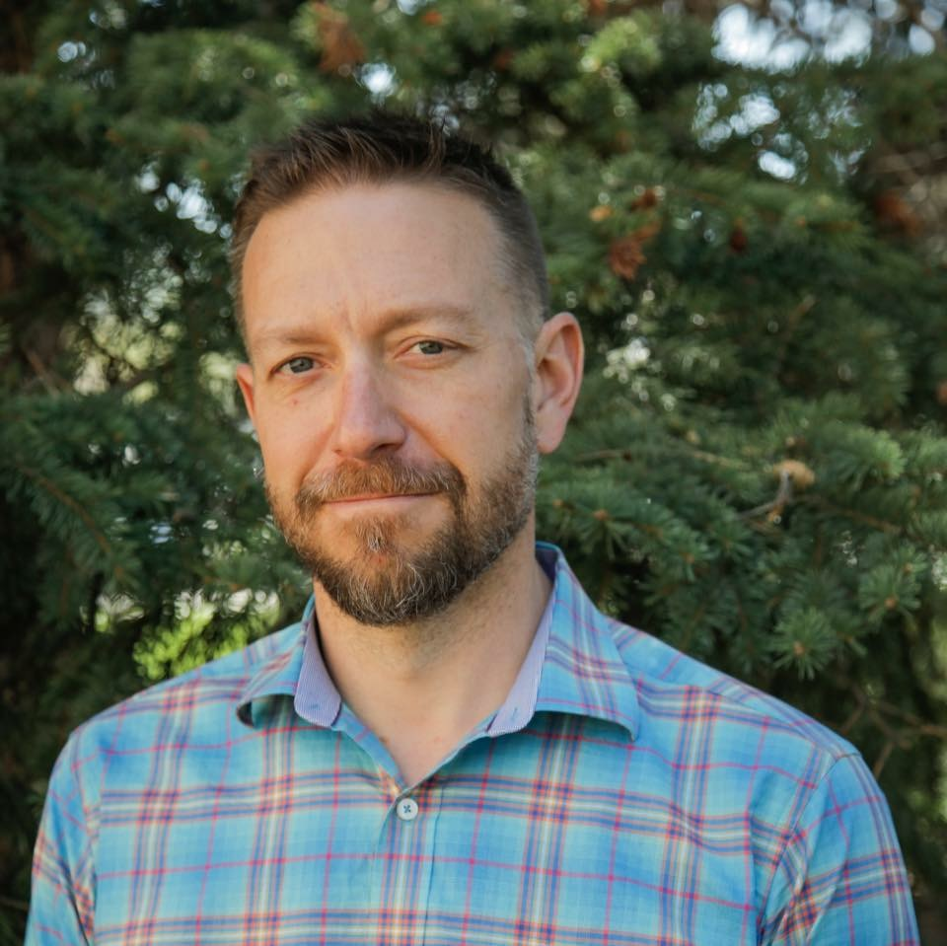
Recruited a Program Scientist for the Terrestrial Ecology Program
at NASA Headquarters
Michael Falkowski
Colorado State University

Slide 8
The View From HQ
2018/2019 were (and continue to be) busy for the NASA Terrestrial Ecology Program
More TE Highlights – Things Coming Down the Pike
CMS 2019 solicitation – May 23 due date
Surface Topography & Vegetation Incubator solicitation – August 1
due date
GEDI Science Team solicitation – TBD
ICESat-2 Science Team solicitation – TBD
Support interagency and international initiatives –
Interagency Arctic Research Policy Committee (IARPC)
    Global Change Research Program (GCRP)
    Satellite Needs Working Group (SNWG)
    Intergovernmental Panel on Climate Change (IPCC)

Slide 9
Serving on NASA Peer Review Panels is your obligation to NASA and to our scientific community.

Slide 10
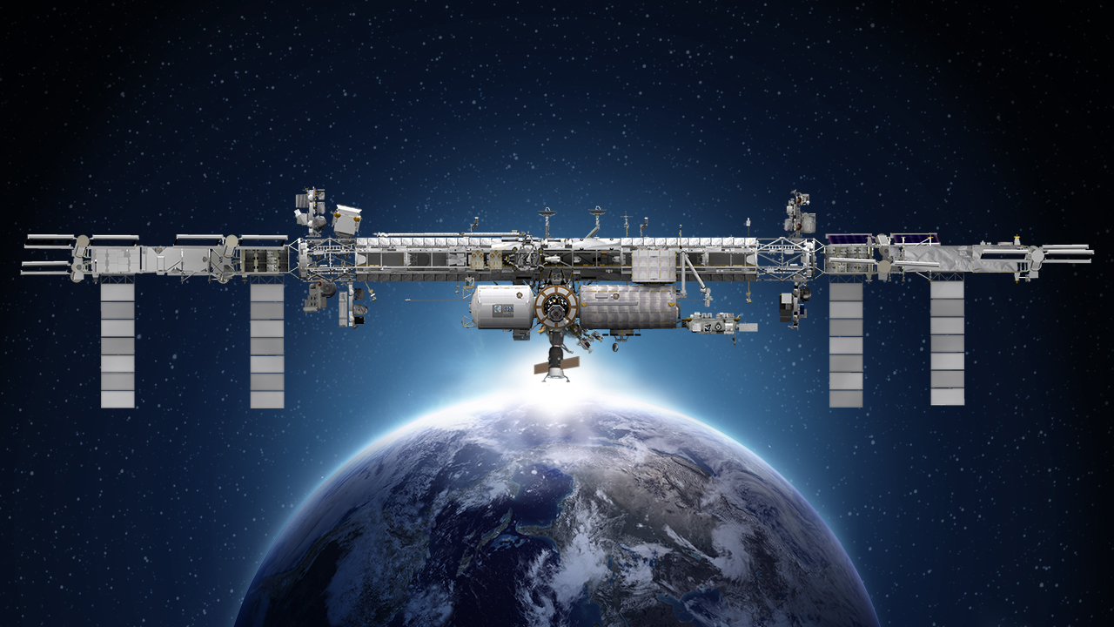
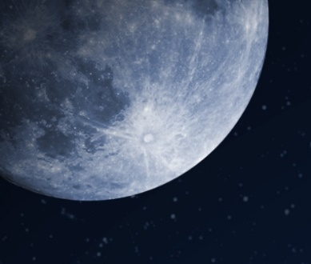
International Space Station
Earth Science Operating Missions
TSIS-1 (2018)
ELC-2
AMS
EMIT (TBD)
ELC-3
ESP-3
ELC-4
Columbus EF
JEMEF
ELC-1
OCO-3 (2019)
GEDI (2018)
ECOSTRESS (2018)
SAGE III (2020)
LIS (2020)
CLARREO PF (2020)
External Logistics Carriers: ELC-1, ELC-2, ELC-3
External Stowage Platforms: ESP-3
Alpha Magnetic Spectrometer
Columbus External Payload Facility
Kibo External Payload Facility
Formulation
Implementation
Primary Ops
Extended Ops
02.22.19
Notes:
Jan. 16, 2018: Updated as part of full set
UPDATED: COLORS AND CONTENT TO MATCH MISSION CHARTS; ADDED KEY AND DATE
12/20/17: Reformatted to 16:9; lost some content that was part of old background (title, moon, lower left box); tried to recreate
12/01/17: edited to remove CATS
5/23: removed TSIS-2
DGH changes 04/14/2017:
Added LIS date (2017); changed TSIS-1 to (2018), GEDI to (2018), OCO-3 to (2018), TISIS-2 to (2020), Ecostress to (2017), Clarreo PF to (2020) per main fleet chart; Removed RapidSCAT; changed istalled instruments to orange (consistent w/ fleet charts); put shadow behind text to make it easier to see; used fleet chart green for shapes
Changes EJD on Feb 4, 2016:
Deleted “CY” on years for SAGE III, CLARREO PF, LIS, OCO-3
Changed dates of TSIS-2 from (2020) to (2020/22)
Changed date of OCO-3 from (2018) to (2017)
Changed dates of GEDI from (2020) to (2018/20)

Slide 11
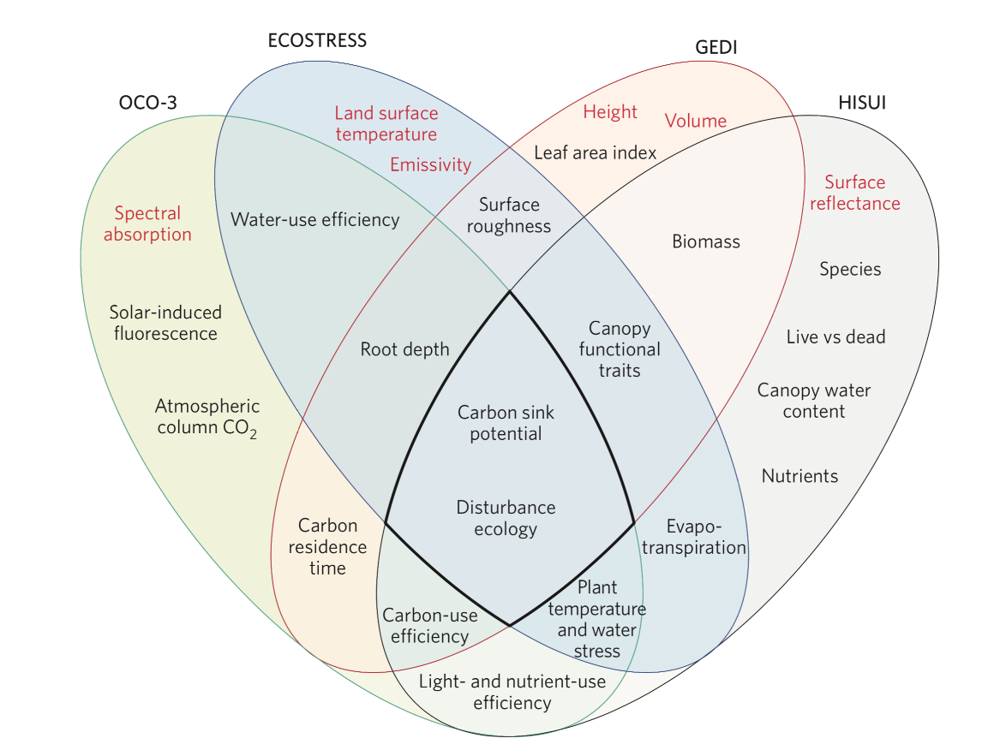
A New Era of Ecosystem Observation from the ISS
ECOSTRESS
GEDI
OCO-3
HISUI

Slide 13
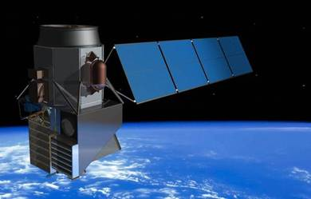
Surface Biology and Geology: a Designated Mission: 2024
What are the structure, function, and biodiversity of Earth’s ecosystems, and how and why are they changing in time and space

Slide 14
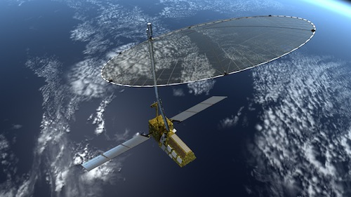
Coming soon (2021) to an orbit near you: NISAR radar for ecosystem structure
Simulated NISAR Data: Timber Volume
NISAR will probably be on orbit together with SBG

Slide 15
2017 Decadal Survey Recommendations
Address 35 key science/applications questions in six categories
Coupling of Water and Energy Cycles
Ecosystem Change
Extending and Improving Weather and Air Quality Forecasts
Sea Level Rise
Reducing Climate Uncertainty
Geological Hazards and Disasters

Slide 16

A.4 - ABoVE Phase 2 Proposals Solicited
The overarching science question for ABoVE is:
How vulnerable or resilient are ecosystems and society to environmental change in the Arctic and boreal region of western North America?

Slide 17
A.4: ABoVE Phase 2

Slide 18
A.4 ABoVE Phase One
ABoVE Phase 1a: Based on the 2014 solicitation, NASA supported 22 investigations that formed the initial stage of the ABoVE field program (2015-2018).
ABoVE Phase 1b: Based on the 2016 solicitation, NASA supported an additional 9 investigations (2017 – 2020) to support the 2017 ABoVE Airborne Campaign.

Slide 19





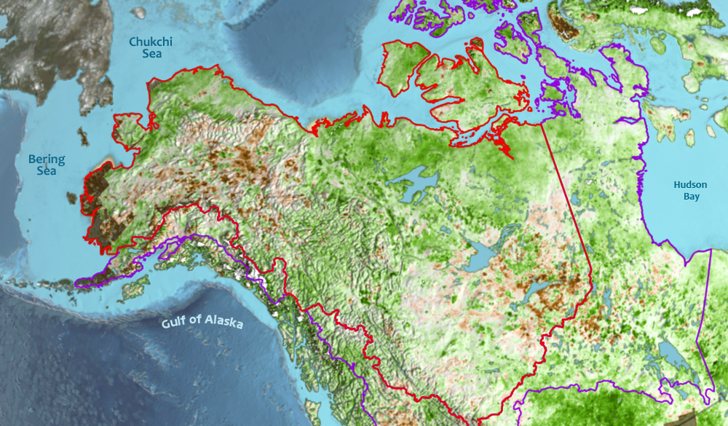
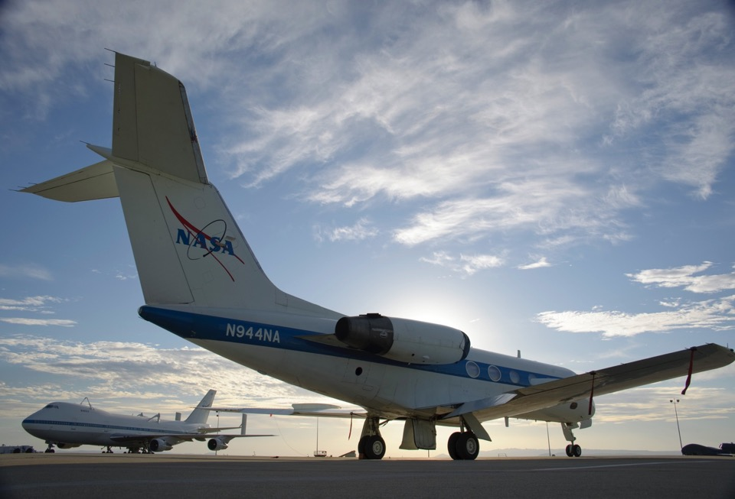
A.4 ABoVE Phase 1b (2017-2020)
2017 ABoVE Airborne Campaign (8 Aircraft Platforms)
Foundational Flights
Jun 2017 Campaign 1A – Spring Soil Active Layer Depth (P- and L-Band Radars)
Jul 2017 Campaign 1B – Mid-Summer Veg Peak (LVIS, AVIRIS, ASCENDS)
Aug 2017 Campaign 1C – Late Summer Active Layer Depth (P and L Band Radars)
PI-led Flights
Apr – Oct 2017 Airborne in situ Atmospheric Carbon Sampling Campaigns
Jun – Sep 2017 CFIS Chlorophyll Fluorescence Campaigns
Jun, Aug 2017 AirSWOT (surface water) Campaigns
Oct 2017 P-Band: Autumn Soil Active Layer Depth
The 2017 ABoVE Airborne Campaign provided a unique data set to help characterize ecosystem vulnerability and resilience across NW North America:
Provides domain-wide context to unify site-level process studies
Links to satellite remote sensing
Diverse set of state-of-the-art sensors, data analyses, & modeling approaches.
Notes:
Note: Sweeney and Conley flights for the C budget will being in ~2 weeks (15 April)

Slide 20
A.4 ABoVE Phase 2 Proposals Solicited
Solar-Induced Fluorescence (SIF) of Northern Ecosystems.
Airborne Science Using Data Collected During
2017 ABoVE Airborne Campaign.
Advancing ABoVE Ecosystem Dynamics and Ecosystem Services Modeling.
Societal Effects of Environmental Change in the ABoVE Study Domain.
ABoVE Science Team Lead(s)

Slide 21
A.4 - ABoVE Phase 2 Selections
ABoVE Phase 2 Selections
 | No. Proposals Selected | No. Proposals Reviewed | % of Proposals
Societal Impacts | 3 | 8 | 37.5%
Airborne Science | 6 | 26 | 23.1%
SIF | 2 | 8 | 25.0%
Modeling | 8 | 31 | 25.8%
ABoVE Science Lead | 2 | 2 | 100.0%
Summary | 21 | 75 | 28.0%
> $17 M of research funding

Slide 22
A.4 - ABoVE Phase 2 Selections
11 of 21 (52%) selected projects are led by a first-time
funded ABoVE PI.
5 New PI’s (24%) were previously ABoVE co-Is
(Armstrong, French, Frankenburg, Butman, Hensley)
6 New PI’s (29%) are new to ABoVE
(Townsend, Duncanson, Fox, Lutz, Chen, Hu)
10 PI’s (47%) are returning PI’s.
(Miller, Miller, Goetz, Goetz, Kimball, Boelman,
Loboda, Bourgeau-Chavez, Fisher, Huemmrich)
7 PI’s (33%) are female

Slide 23
It is my intention that ABoVE be a nine- to ten-year research program.
ABoVE continues to have a very high profile within NASA and across the federal government and beyond (GCRP, IARPC)

